Slide 1

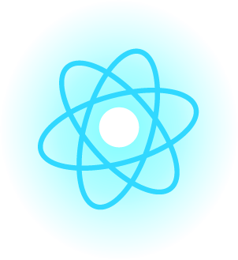
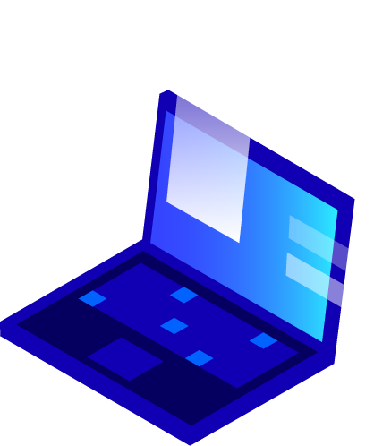


Blockchain for Sneakers Authentication and Generation of Related NFTs with GAN
Mirko Del Moro Francesco Vannoni

Slide 2
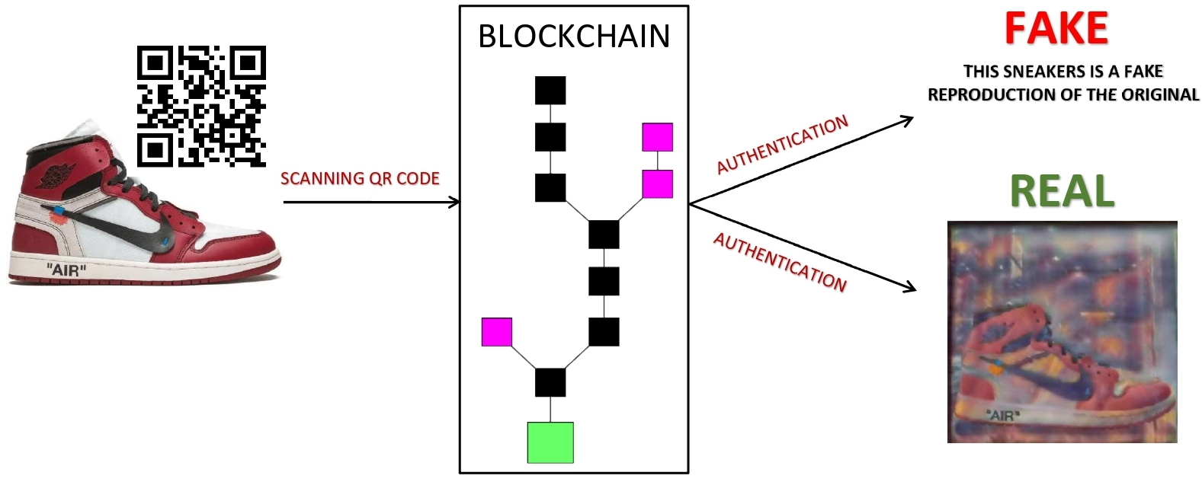
Overview
The goal of this is work is to authenticate sneakers, since for these products a counterfeiting market is widespread.
How do that? By creating a system based on the blockchain, which contains immutable information related to the product.
1

Slide 3
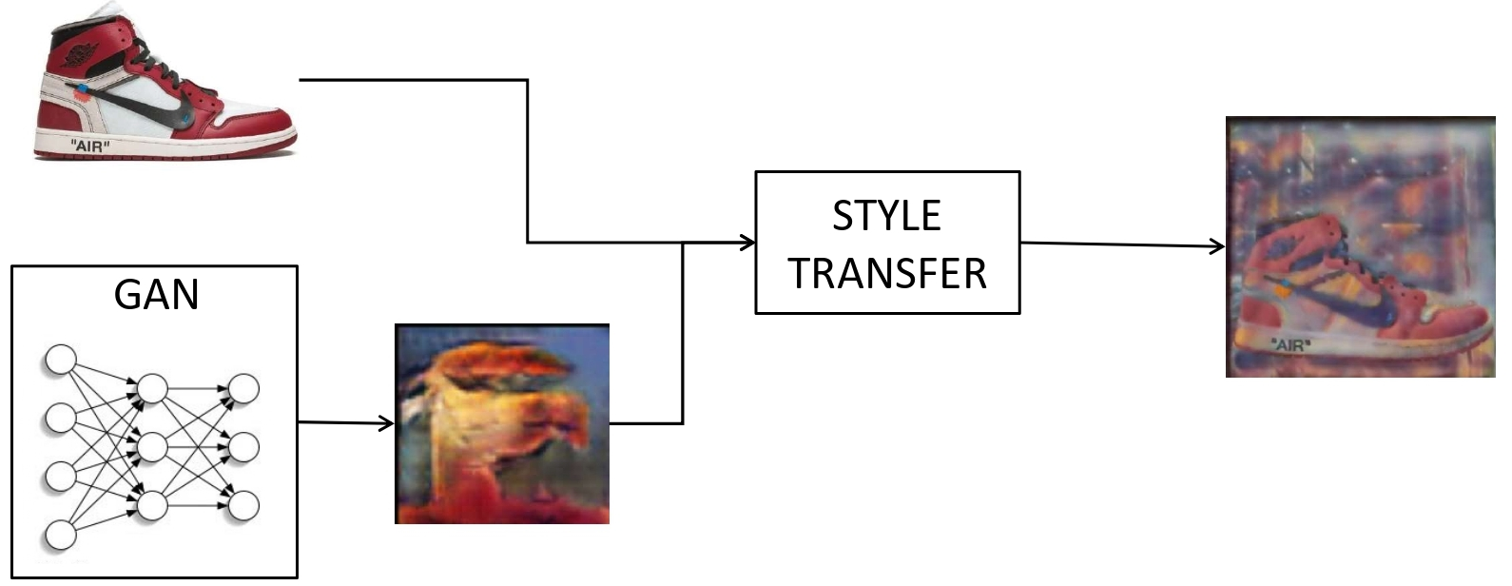
Overview
For each sneakers is associated a NFT which is automatically generated by a Generative Adversarial Network and a Style Transfer.
Each NFT is referred to the product since the sneaker’s image is used in order to generate it .
2

Slide 4
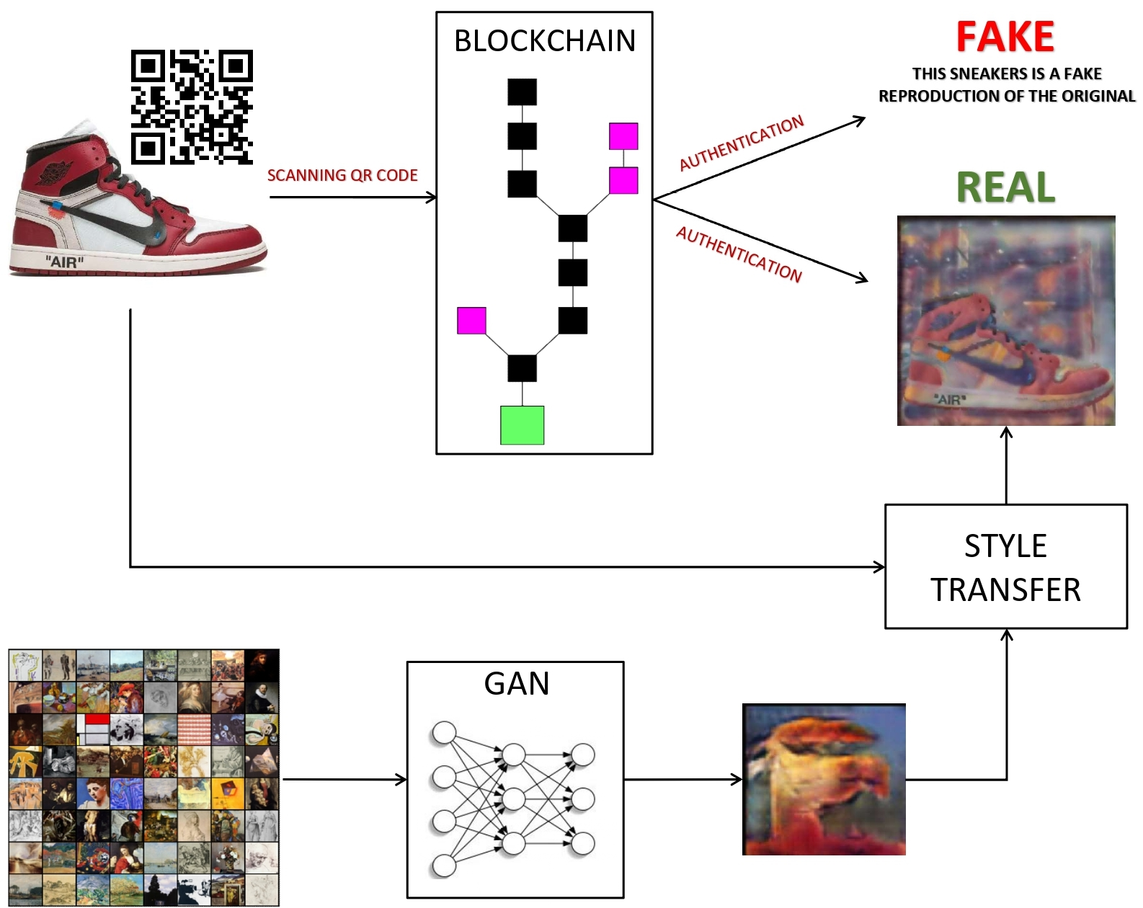
Overview
3

Slide 5
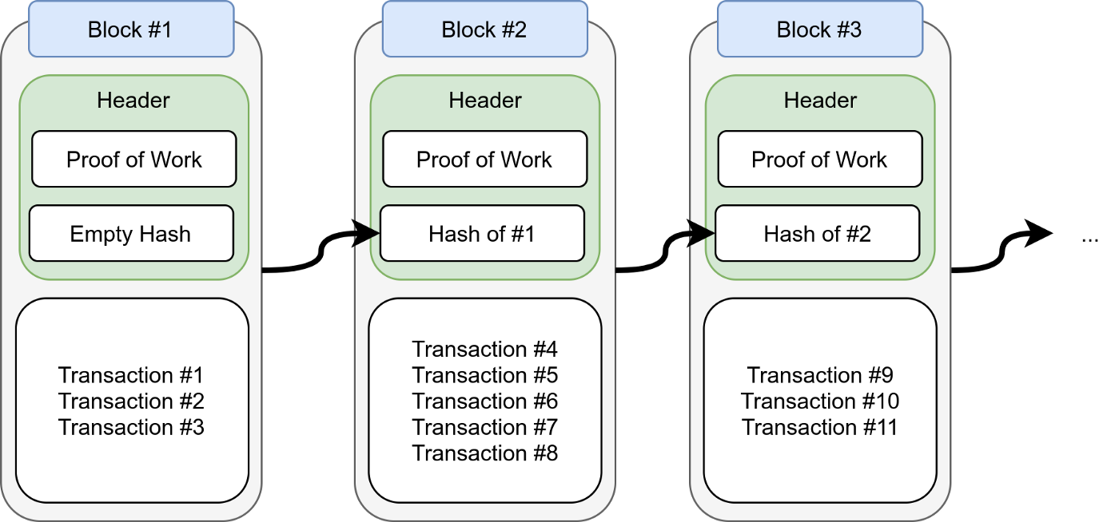
Blockchain: Features
Our Blockchain system:
Blocks hash: SHA-256 hash function
Transactions hash: don’t compute hash for each transaction
Difficulty: increase difficult factor as far as the chain becomes longer
Proof of work: different values of nonce to get a hash that satisfies the difficulty criteria
4

Slide 6
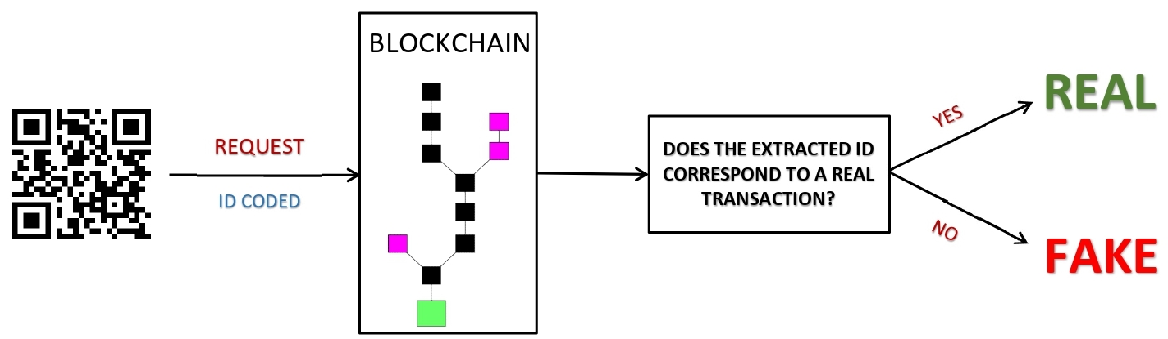
Blockchain: Transaction and Data Retrieval
The data we need to authenticate is stored into transactions. Each of them contains two data:
ID: the transaction id
NFT link: the link to the NFT corresponding to the sneakers
5

Slide 7
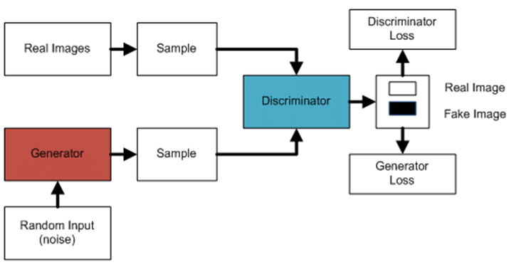
NFT: GAN Generation
The NFT is generated by combining the sneakers image with a style image. The last one is created through a Generative Adversarial Network.
6

Slide 8
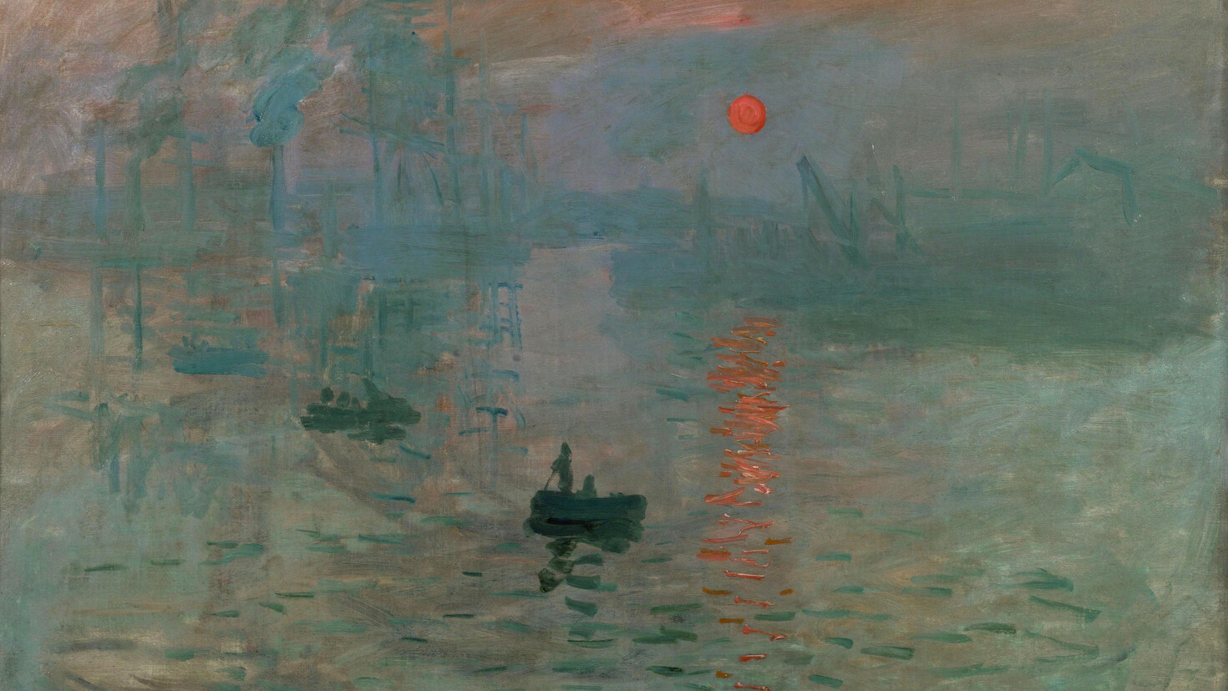
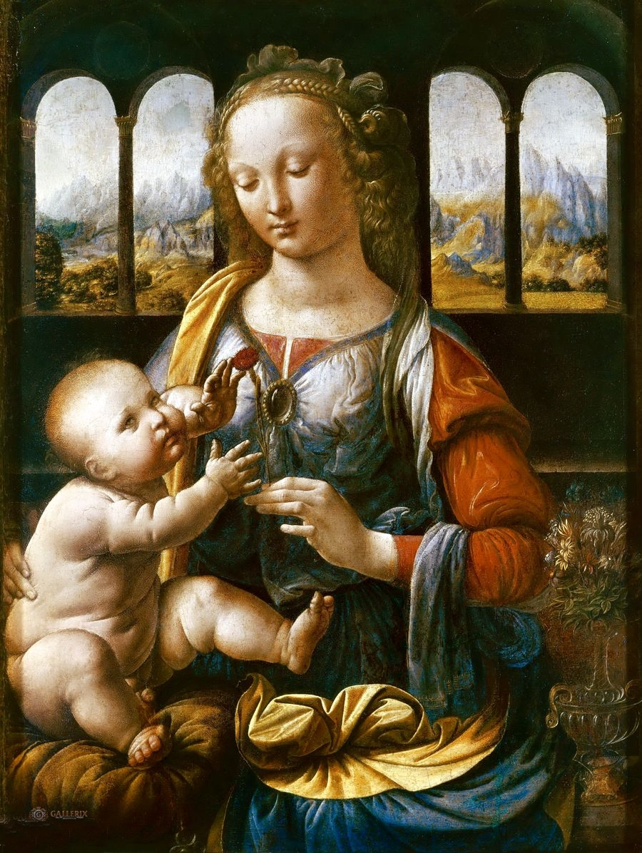
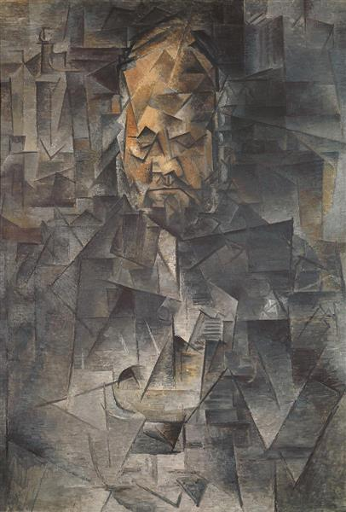
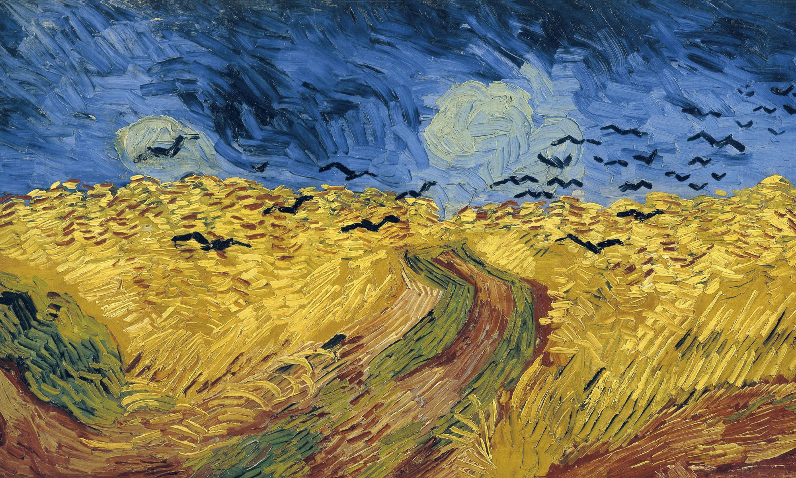
NFT: GAN Generation
Dataset: Best Artworks of All Time, a collection of artworks of the most influential artists of all time. It contains 8683 artworks of 50 different artists.
Generator: generates new data instances. It converts a latent tensor into an image tensor through transposed convolutions.
Discriminator: evaluates the data created by the generator and it decides whether each instance of data that it reviews belongs to the actual training dataset or not.
7

Slide 9
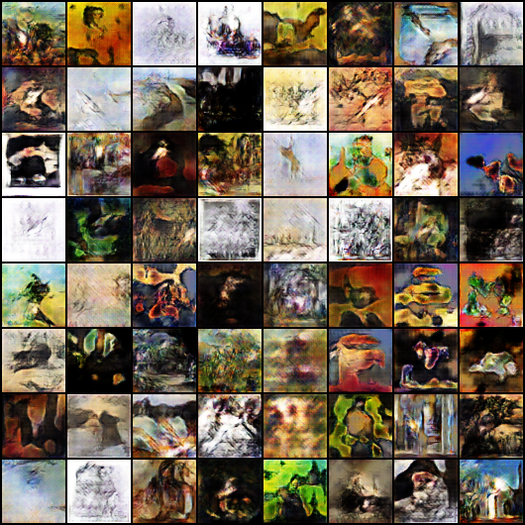
NFT: GAN Generation
Training and results:
Grid of 64 images
Epochs: 150
Batch Size: 128
Optimizer: Adam
Fit function to train discriminator and generator in tandem for each batch of data
8

Slide 10
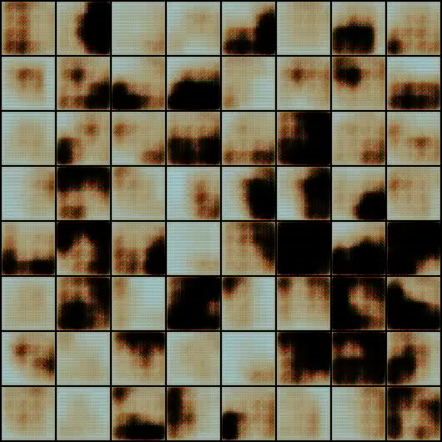
NFT: GAN Generation
9

Slide 11
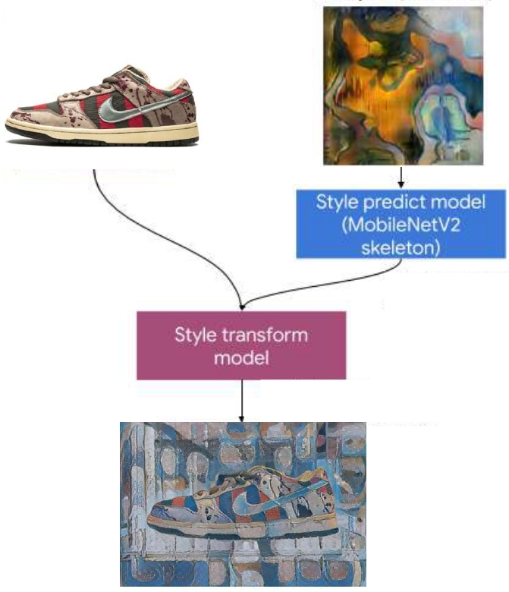
NFT: Style Transfer
Style Transfer is used to create the NFT image by blending them the sneakers image and the style one, which has been generated previously by the GAN. Style Transfer model consists of two submodels:
Style prediction model: a MobilenetV2-based neural network.
Style transform model: a neural network that applies a style bottleneck vector to the sneakers image and creates the NFT image.
10

Slide 12
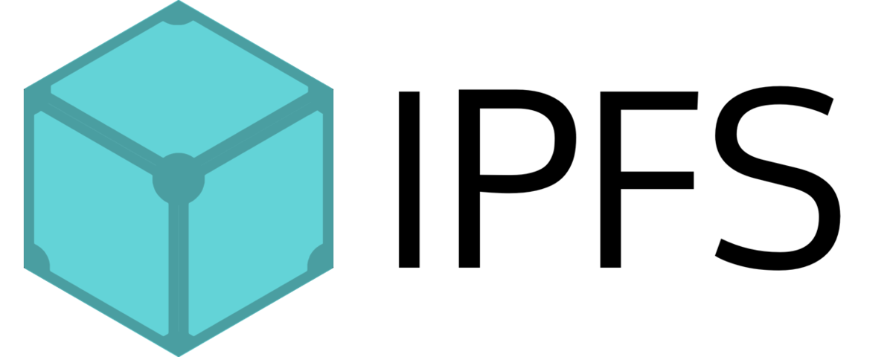
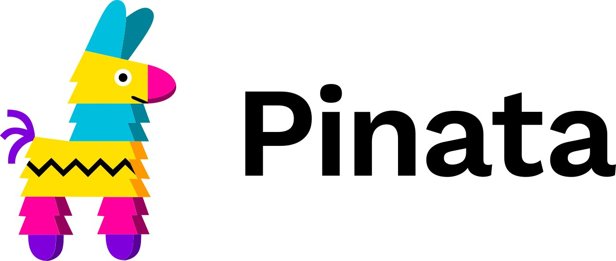
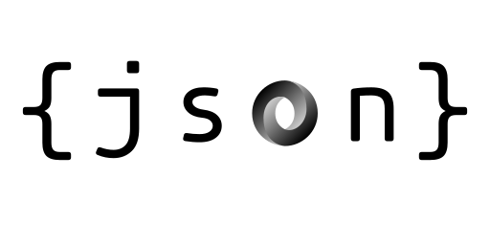
NFT: Metadata
Since uploading images to the blockchain is very expensive, we upload the link of the image to the blockchain, and we store the image on an IPFS (by using Pinata).
A json file containing the metadata has been associated to each image. The metadata contains:
image: link to the image
token_id: id of the token, corresponding to the id of the transaction
name: NFT name
sneakers_type: sneakers model
11

Slide 13
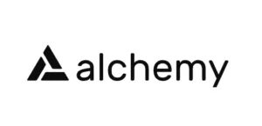
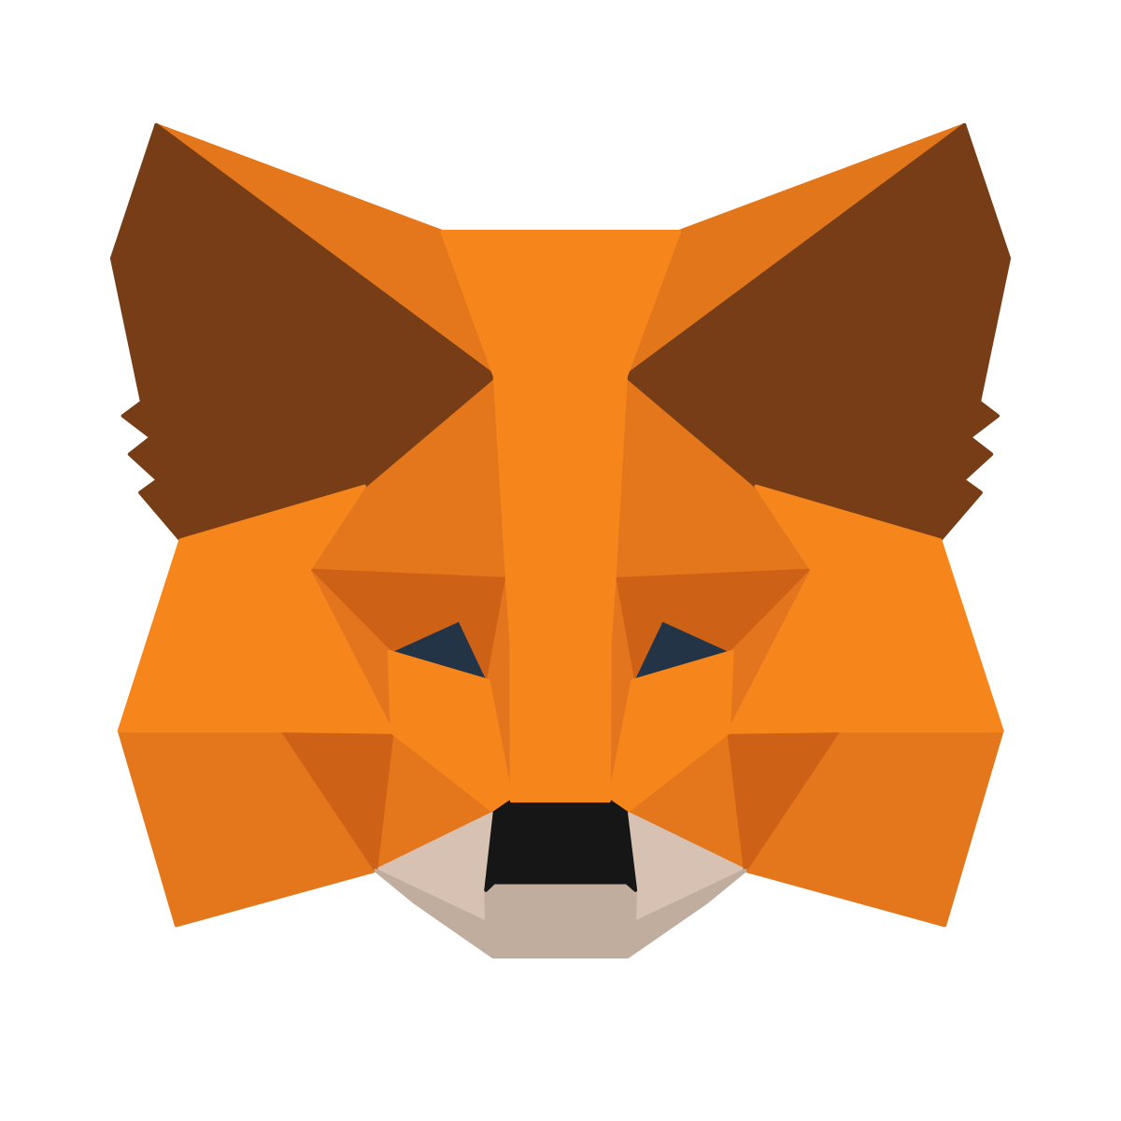
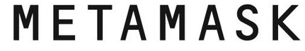
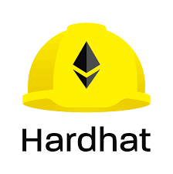
NFT: Environment Set-Up
In order to make Ethereum development easy we have used the following tools:
Alchemy as blockchain developer platform
Ropsten test network (free to use, ideal for our purpose)
Ropsten faucet to get fake ETH
Metamask as digital wallet
Hardhat to build the smart contract locally before than live
12

Slide 14
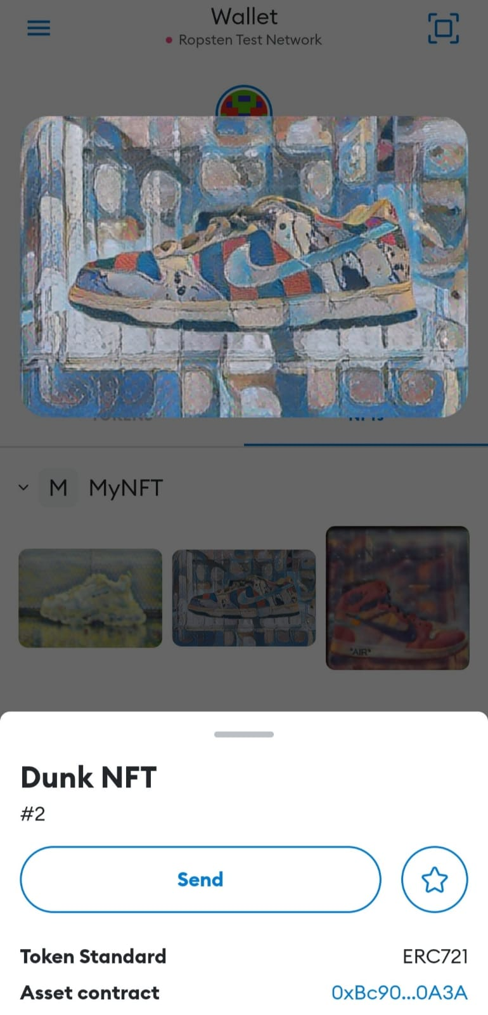
NFT: Smart Contract and Minting
Smart contract written in Solidity language.
Openzeppelin library exploited to inherit all the methods of the
ERC-721 Standard
Through Hardhat the script is deployed, if no error occurs, the
transaction is visible on Ropsten Etherscan
Before minting and signing some parameters as gas (the estimated
gas needed to complete the transaction) and MaxPriorityFee (the
estimated fee to bid per gas) are specified
13

Slide 15
Conclusions
The whole system can be framed as a 2-step authentication. In order to get the final NFT, the data must be validated by two blockchains.
Possible improvements:
Enhance blockchain security
Enhance resolution of images generated
14

Slide 16
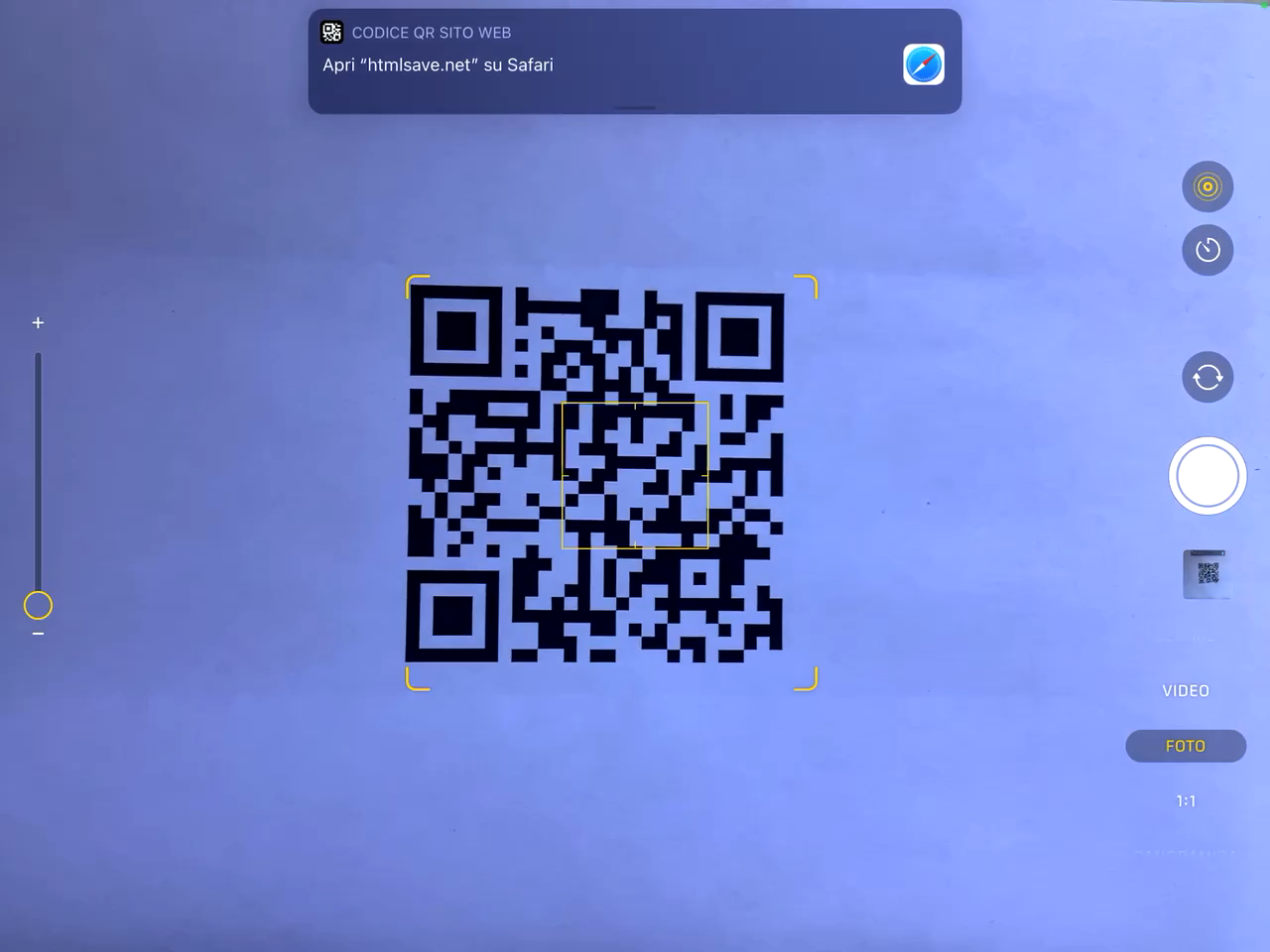
DEMO: Fake
DEMOs
15

Slide 17
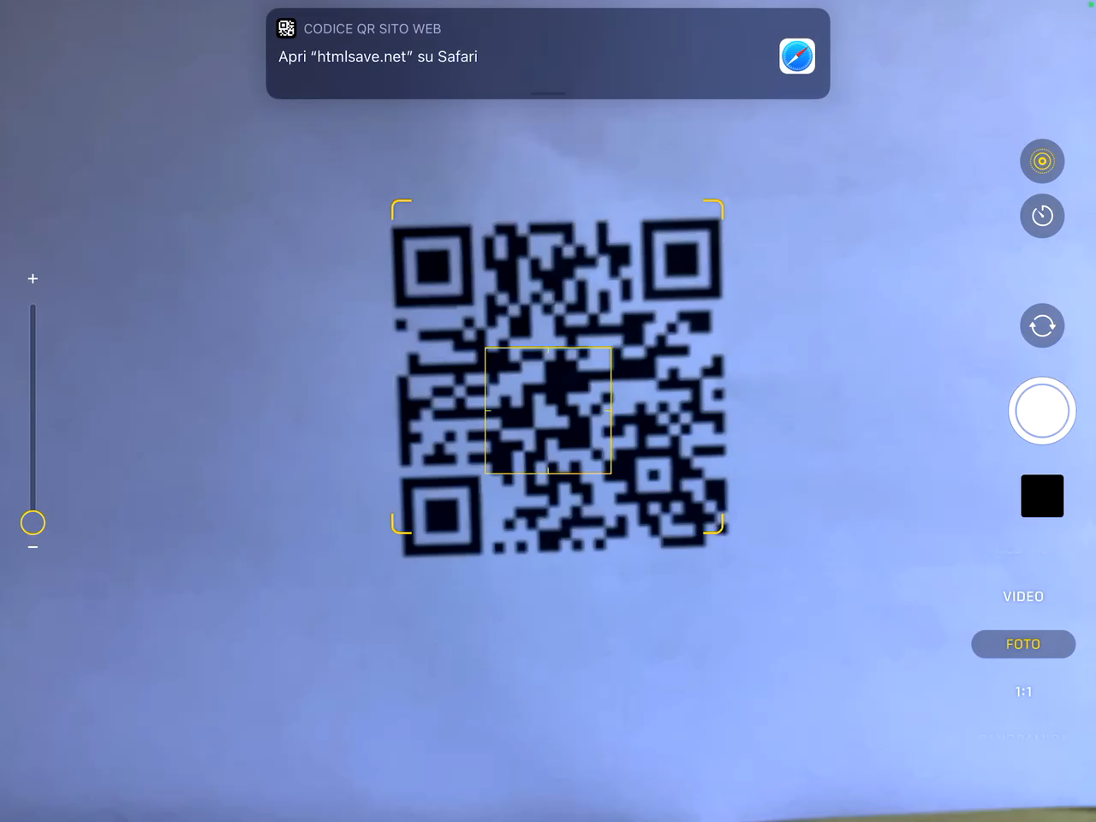
DEMO: Authentic
DEMOs
16

Slide 18
Thanks for your attention!

